Slide 1


Flight Fare Prediction Using ML
Group-1

Slide 2
Team Participants:
S.NO | NAME | E-mail | Role
1 | Pavan Sai Megha Vardhan . K | pavansaimeghavardhanketireddi@my.unt.edu
2 | Suresh . N | sureshnarra@my.unt.edu
3 | Chandu . K | chandukurre@my.unt.edu
4 | Meenakshi . B | meenakshibojja@my.unt.edu
5 | Neha . T | nehathatikonda@my.unt.edu

Slide 3
Work Flow:
Research Data Set
Data Cleaning
Data Pre-Processing
Feature Selection
Applying ML Models
Hyper Parameter Tuning
UI Using Flask
Deployment Using AWS EC2 Instance

Slide 4
Work Flow:
We collaborated on the project by assigning specific tasks such as data preprocessing, visualization, result prediction and User Interface deployment. We regularly discussed our progress, shared updates on the tasks, and collectively worked to enhance techniques and methodologies for improved performance. Our collaborative effort included sharing research findings and jointly addressing challenges. In particular, we delved into researching data imputation techniques and their implementation, and the details of these findings are included in the references section of this document.

Slide 5
Abstract
The project focuses on the utilization of advanced pricing algorithms employed by airlines to optimize profits. These algorithms consider various factors such as flight duration, proximity to the departure date, and departure or arrival times, duration and Number of stops resulting in dynamic changes in ticket prices. The advent of Machine Learning (ML) presents an opportunity to gain deeper insights into these pricing principles and construct models that can enhance our ability to accurately predict fluctuations in ticket prices.
The primary objective of our project is to explore diverse machine learning algorithms to identify the most suitable model for our dataset. Ultimately, our aim is to provide customers with precise predictions of ticket prices, thereby offering an improved understanding of the factors influencing pricing dynamics in the airline industry. The dataset we are working with encompasses comprehensive information about airline flights, including origin and destination cities, the number of stops, journey duration, days till departure, and ticket costs.
To achieve our goal, we plan to employ machine learning models such as Random Forest, leveraging their capabilities to achieve maximum accuracy in predicting ticket prices. Additionally, we are developing a user interface using Flask to provide a seamless experience for users interacting with our models. Furthermore, the deployment of our application is facilitated through an AWS EC2 instance, ensuring accessibility and usability for a broader audience. In summary, our project seeks to harness the power of machine learning to enhance price prediction accuracy in the airline industry and deliver a user-friendly interface for customers.

Slide 6
Describing Data Set:
Our Data Contains :
A number of columns in the dataset for the "Flight Fare Prediction using Machine Learning" research offer detailed information on individual airline trips. Our data set is based on Indian Air Lines and it contains data of year 2019 only and our source and destinations are some important and most travelled cities of India. The carrier operating the flight is identified in the "Airline" column, and the scheduled date of the travel is indicated in the "Date_of_Journey" column.
The departing city or airport and the destination city or airport are indicated in the "Source" and "Destination" columns, respectively. Any layovers in the flight path are indicated in the "Route" column. The "Dep_Time" and "Arrival_Time" columns record time-related data by indicating the departure and arrival timings, respectively. The overall length of the flight is shown by the "Duration" column, and the total number of stops made during the trip is categorized by the "Total_Stops" column (e.g., '0 stops', '1 stop', '2 stops'). The main target variable for prediction in this project is the "Price" column, representing the fare or price of the flight ticket. The objective is to leverage machine learning techniques, such as Random Forest, to predict flight fares accurately based on the information provided in the other columns of the dataset.

Slide 7
Design Flow Chart:
Kaggle
Data Collection
Data Cleaning
Data Pre-Processing
Check Data Set For Null Values
Dropping The Column Having non-impacting Information.
exploratory data analysis:
effective manipulation of data sources. Ex: we have Date_of_Journey as a object data type. Therefore, we need to convert this datatype into timestamp so we can use this column properly for prediction.
Splitting Training and testing data
ML Modelling
UI and Deployment

Slide 8
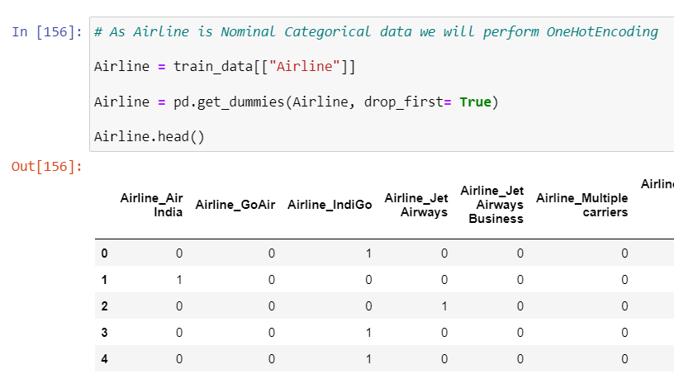
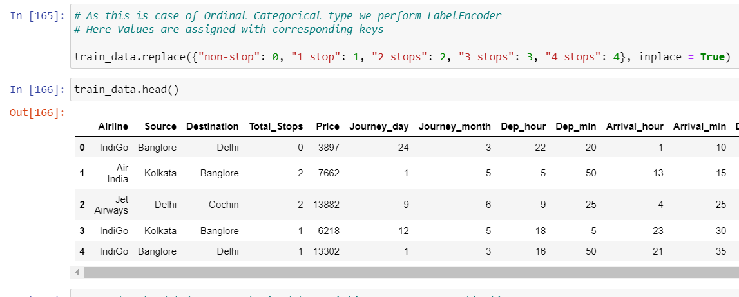
Implementation Of Data Processing Techniques:
In our Project we have Categorical data.One can find many ways to handle categorical data. Some of them categorical data are,
Nominal data --> data are not in any order --> OneHotEncoder is used in this case
Ordinal data --> data are in order --> LabelEncoder is used in this case
We implemented both techniques to our data set

Slide 9
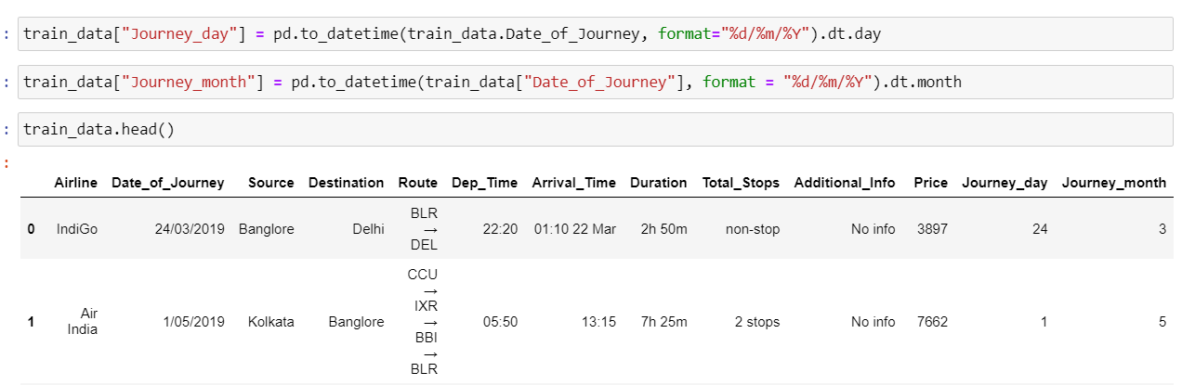
Data Processing Techniques:
we have Date_of_Journey as a object data type. Therefore, we need to convert this datatype into timestamp so we can use this column properly for prediction.
Similarly we did this implementation to other column :Dep_Time, Arrival_Time, Duration.

Slide 10
Modelling::
Regression finds correlations between dependent and independent variables. Therefore, regression algorithms help predict continuous variables. The Regression algorithm’s task is finding the mapping function so we can map the input variable of “x” to the continuous output variable of “y.” In Our Project We need to find the Flight fare depending on other Parameters so this comes under Regression Modelling.
Here In this Project we Used Three Kinds of Regression Algorithms They Are:
Linear Regression
KNN- Regression
Random Forest Regression
After Comparing the Accuracy for these three algorithms we came to a conclusion that random forest has more accuracy than other two models so we further tuned the Random forest regressor hyper parameters to get more better accuracy.
After Hyper Parameter Tuning we got 82% of Accuracy with the test data.

Slide 11
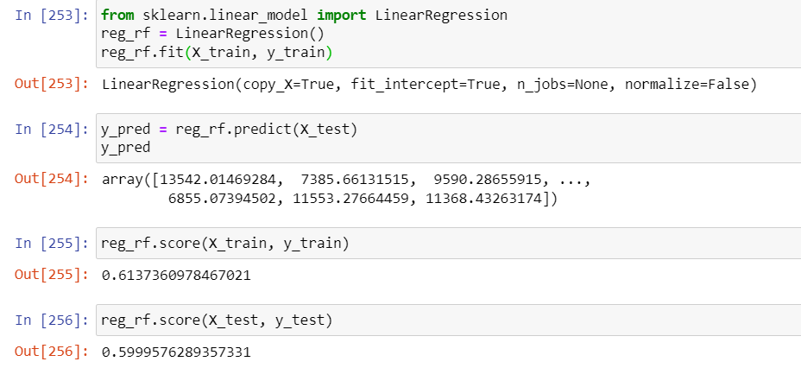
Evaluation and Justification of accuracy of Models used:
Sklearn's model.score(X,y) calculation is based on co-efficient of determination i.e R^2 that takes model.score= (X_test,y_test). The y_predicted need not be supplied externally, rather it calculates y_predicted internally and uses it in the calculations.
This is how scikit-learn calculates
model.score(X_test,y_test):
u = ((y_test - y_predicted) ** 2).sum()
v = ((y_test - y_test.mean()) ** 2).sum()
score = 1 - (u/v)
So we used this method to calculate accuracy of model.
Linear Regression

Slide 12
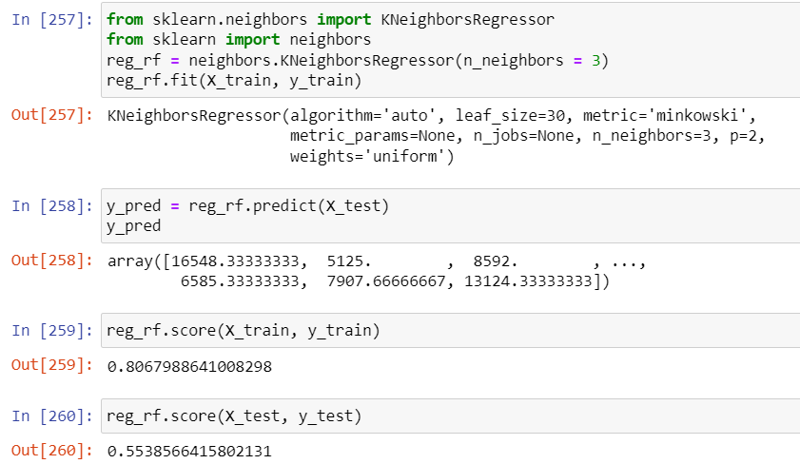
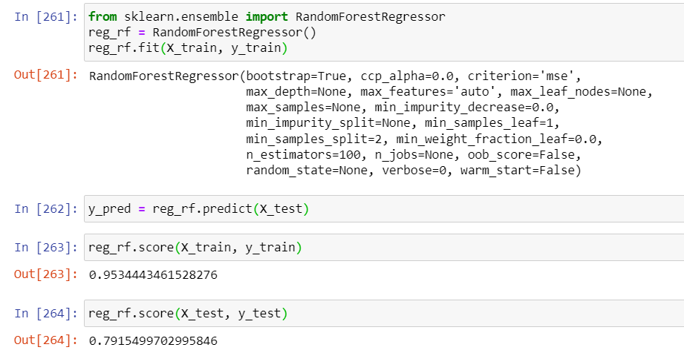
KNN Regression
Random Forest
*After Comparing these three algorithms we conclude that random forest have higher accuracy so further to increase accuracy we hyper tuned parameters of Random forest model.

Slide 13
References:
From These website we took panda syntax as a reference.
https://pandas.pydata.org/docs/reference/frame.html
Learned How to do Data Cleaning and some Pre Processing Techniques.
https://www.youtube.com/watch?v=x08AN87G0mg&t=490s&ab_channel=WsCubeTech%21ENGLISH
Learned working with categorical data in machine learning
https://www.analyticsvidhya.com/blog/2020/03/one-hot-encoding-vs-label-encoding-using-scikit-learn/
From Kaggle we Took this data Set for our model. This project is our reference Project.
https://www.kaggle.com/code/arunkumaroraon/ensemble-model-with-regression-technique/notebook
From This Tutorial we Learned How to Deploy our model Into AWS EC2 Instance.
https://www.youtube.com/watch?v=oOqqwYI60FI&ab_channel=KrishNaik
Apart from the above Reference Project we Tried out KNN Regression and also Tuned Hyper Parameters of Random Forest to Get Better Prediction. We also Used Extra Tree regressor to find out which Parameter is most dependable Parameter out of our data columns available. And also plotted it using a bar graph in our model. We also did User Interface using Flask and deployed it using AWS EC2 Instance.
In future the scope of advancement in our project are: we can Improve our data set by adding wide range of data such as past and future data, improve features like Class(Premium, Business).
Work on Seasonal routes are those that have significant fluctuations in demand and supply throughout the year, such as ski destinations, beach resorts, or holiday spots.

